Slide 1
Why Rent?
The Association Decision

Slide 2
Economics
Balances over six months not reimbursed
Loss to association revenue
Picked up by other homeowners
Requires a decrease in budgeted items
Lenders require stable financials to make loans
Refinance might not be approved
New mortgage might not be approved

Slide 3
Association Process-initial
Court orders possession
Sheriff serves eviction notice to occupants
Eviction is scheduled and completed
Condition of unit is assessed
Determination of cost to repair and clean

Slide 4
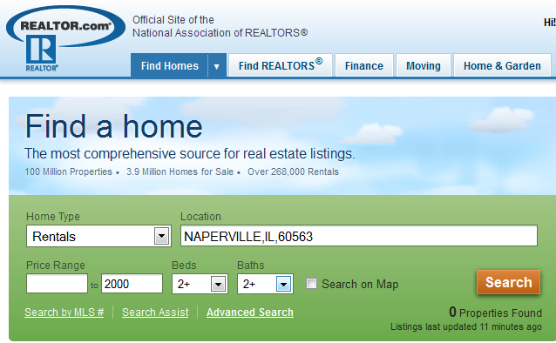
Association Process-renting
Realtor provides contract to list in Multiple Listing Service
Property Manager provides keys for lockbox
Unit is advertised for rent on popular websites
Agents show unit to clients
Potential tenants are presented to board for approval
Credit report on anyone 18+
Criminal Background Check, all 50 states, all 18+
Employment verification, if needed

Slide 5
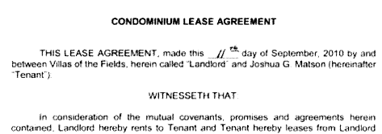
Association Process-tenant
Realtor prepares lease for signatures of tenant(s) and board member (landlord)
Realtor collects rent and security in secured funds
Realtor meets with tenants
Keys
Rules and Regs
Reminder that rented on AS IS basis
Property Management collects rent

Slide 6
Advantages
Planned budget is met
Potential loss is minimized
Unit is not vacant

Slide 7
Cost vs. Benefit
Legal-Attorney, Court, Sheriff and Eviction
Critical Repairs and Clean Up
Realtors—one month’s rent
Rent offsets costs
Rent allows positive cash flow for unit
Below market rent rate results in quicker rent payments

Slide 8
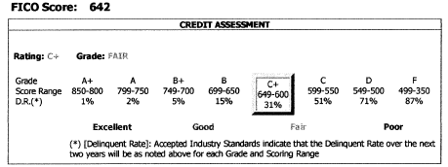
Tenant Considerations
Credit Scoring-Likely to pay monthly or not?
Yes! Paid for full year on time!
Other factors?

Slide 9
Tenant Considerations
Income relative to rent and other debts
Job stability
Reason for moving
Employer relocation
Issues with current landlord
Looking to reduce rent factor
Foreclosure or short sale
Any criminal records or evictions
If multiple applicants, what is the process the board will follow?

Slide 10
Fair Housing
Rent equally without regard to
Race
Color
National origin
Religion
Sex
Familial status
Handicap
Follow same rental process for every applicant

Slide 11
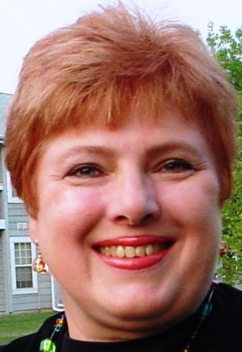
Why Paulette Pekala- Managing Broker?
Experienced Realtor
Renting units for Associations
Processing Potential Tenant Applications
Verifying Credit and Criminal Background
Working with Association Boards
Board Member, Bridgewater Condominium Association, 10 years
Master of Arts, Business Administration from Governors State University
Bachelor of Arts, Secondary Education from DePaul University
Local, Active Community Resident for over 25 years
PEKALA REALTY P.C. Lisle, IL

Slide 12
Pekala’s Contact Information
630-470-5533
PPekala@PekalaRealty.com
www.PekalaRealty.com
Member Main Street Organization of Realtors
Listings in Multiple Listing Service (MLS)
Hundreds of websites including
Trulia.com
Realtor.com
Craigslist.com in professional section

Slide 13
Association Success Stories
Aurora
Hanover Park
Lisle
Naperville
Plainfield
St. Charles
Wheaton
Winfield
Woodridge

